Slide 1
Data Structures – Week #2
Algorithm Analysis
&
Sparse Vectors/Matrices
&
Recursion
Notes:
Week #1

Slide 2
Outline
Performance of Algorithms
Performance Prediction (Order of Algorithms)
Examples
Exercises
Sparse Vectors/Matrices
Recursion
Recurrences
Borahan Tümer

Slide 3
Algorithm Analysis

Slide 4
Performance of Algorithms
Algorithm: a finite sequence of instructions that the computer follows to solve a problem.
Algorithms solving the same problem may perform differently. Depending on resource requirements an algorithm may be feasible or not. To find out whether or not an algorithm is usable or relatively better than another one solving the same problem, its resource requirements should be determined.
The process of determining the resource requirements of an algorithm is called algorithm analysis.
Two essential resources, hence, performance criteria of algorithms are
  execution or running time
  memory space used.
Borahan Tümer

Slide 5
Performance Assessment - 1
Execution time of an algorithm is hard to assess unless one knows
  the intimate details of the computer architecture,
  the operating system,
  the compiler,
  the quality of the program,
  the current load of the system and
  other factors.
Borahan Tümer

Slide 6
Performance Assessment - 2
Two ways to assess performance of an algorithm
  Execution time may be compared for a given algorithm using some special performance programs called benchmarks and evaluated as such.
  Growth rate of execution time (or memory space) of an algorithm with the growing input size may be found.
Borahan Tümer

Slide 7
Performance Assessment - 3
Here, we define the execution time or the memory space used as a function of the input size.
By “input size” we mean
  the number of elements to store in a data structure,
  the number of records in a file etc…
  the nodes in a LL or a tree or
  the nodes as well as connections of a graph
Borahan Tümer
Notes:
Week #1

Slide 8
Assessment Tools
We can use the concept the “growth rate or order of an algorithm” to assess both criteria. However, our main concern will be the execution time.
We use asymptotic notations to symbolize the asymptotic running time of an algorithm in terms of the input size.
Borahan Tümer

Slide 9
Asymptotic Notations
We use asymptotic notations to symbolize the asymptotic running time of an algorithm in terms of the input size.
The following notations are frequently used in algorithm analysis:
  O (Big Oh) Notation (asymptotic upper bound)
  Ω (Omega) Notation (asymptotic lower bound)
  Θ (Theta) Notation (asymptotic tight bound)
  o (little Oh) Notation (upper bound that is not asymptotically tight)
  ω (omega) Notation (lower bound that is not asymptotically tight)
Goal: To find a function that asymptotically limits the execution time or the memory space of an algorithm.
Borahan Tümer

Slide 10
O-Notation (“Big Oh”)
Asymptotic Upper Bound
Mathematically expressed, the “Big Oh” (O()) concept is as follows:
Let g: N → R* be an arbitrary function.
O(g(n)) = {f: N → R* | (∃c ∈ R⁺)(∃n₀ ∈ N)(∀n ≥ n₀) [f(n)≤ cg(n)]},
  where R* is the set of nonnegative real numbers and R⁺ is the set of strictly positive real numbers (excluding 0).
Borahan Tümer

Slide 11
O-Notation by words
Expressed by words; O(g(n)) is the set of all functions f(n) mapping (→) integers (N) to nonnegative real numbers (R*) such that (|) there exists a positive real constant c (∃c ∈ R⁺) and there exists an integer constant n₀ (∃n₀ ∈ N) such that for all values of n greater than or equal to the constant (∀n ≥ n₀), the function values of f(n) are less than or equal to the function values of g(n) multiplied by the constant c (f(n)≤ cg(n)).
In other words, O(g(n)) is the set of all functions f(n) bounded above by a positive real multiple of g(n), provided n is sufficiently large (greater than n₀). g(n) denotes the asymptotic upper bound for the running time f(n) of an algorithm.
Borahan Tümer

Slide 12
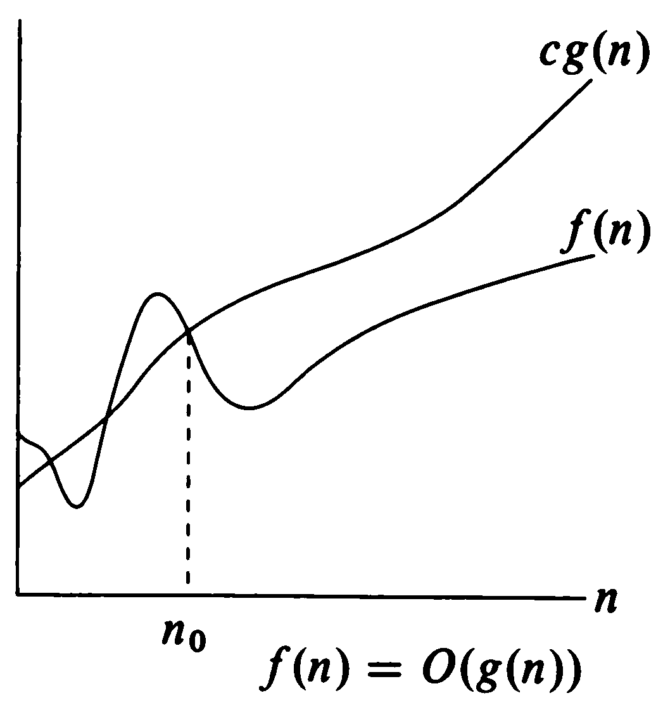
O-Notation (“Big Oh”)
Asymptotic Upper Bound
Borahan Tümer
Notes:
Week #1

Slide 13
Θ-Notation (“Theta”)
Asymptotic Tight Bound
Mathematically expressed, the “Theta” (Θ()) concept is as follows:
Let g: N → R* be an arbitrary function.
Θ(g(n)) = {f: N → R* | (∃c₁,c₂ ∈ R⁺)(∃n₀ ∈ N)(∀n ≥ n₀)
[0 ≤ c₁g(n)≤ f(n)≤ c₂g(n)]},
  where R* is the set of nonnegative real numbers and R⁺ is the set of strictly positive real numbers (excluding 0).
Borahan Tümer

Slide 14
Θ-Notation by words
Expressed by words; A function f(n) belongs to the set Θ(g(n)) if there exist positive real constants c₁ and c₂ (∃c₁,c₂∈R⁺) such that it can be sandwiched between c₁g(n) and c₂g(n) ([0 ≤ c₁gn)≤ f(n)≤ c₂g(n)]), for sufficiently large n (∀n ≥ n₀).
In other words, Θ(g(n)) is the set of all functions f(n) tightly bounded below and above by a pair of positive real multiples of g(n), provided n is sufficiently large (greater than n₀). g(n) denotes the asymptotic tight bound for the running time f(n) of an algorithm.
Borahan Tümer

Slide 15
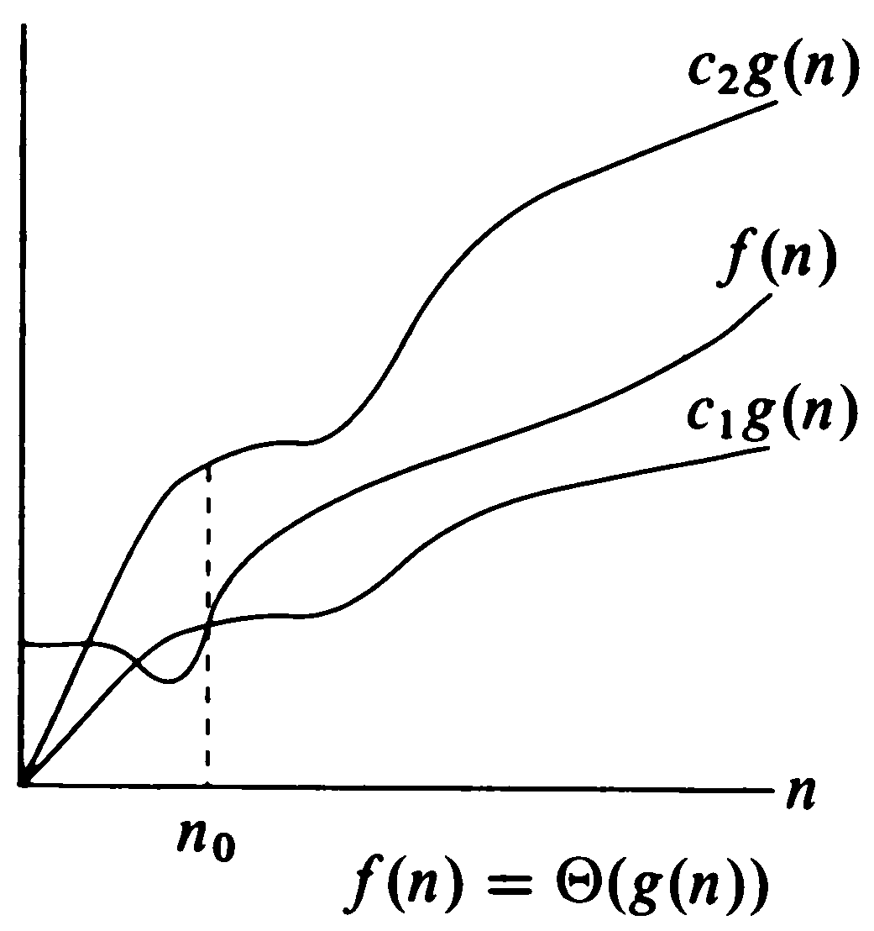
Θ-Notation (“Theta”)
Asymptotic Tight Bound
Borahan Tümer
Notes:
Week #1

Slide 16
Ω-Notation (“Big-Omega”)
Asymptotic Lower Bound
Mathematically expressed, the “Omega” (Ω()) concept is as follows:
Let g: N → R* be an arbitrary function.
Ω(g(n)) = {f: N → R* | (∃c ∈ R⁺)(∃n₀ ∈ N)(∀n ≥ n₀)
[0 ≤ cg(n)≤ f(n)]},
  where R* is the set of nonnegative real numbers and R⁺ is the set of strictly positive real numbers (excluding 0).
Borahan Tümer

Slide 17
Ω-Notation by words
Expressed by words; A function f(n) belongs to the set Ω(g(n)) if there exists a positive real constant c (∃c∈R⁺) such that f(n) is less than or equal to cg(n) ([0≤ cg(n)≤ f(n)]), for sufficiently large n (∀n ≥ n₀).
In other words, Ω(g(n)) is the set of all functions t(n) bounded below by a positive real multiple of g(n), provided n is sufficiently large (greater than n₀). g(n) denotes the asymptotic lower bound for the running time f(n) of an algorithm.
Borahan Tümer

Slide 18
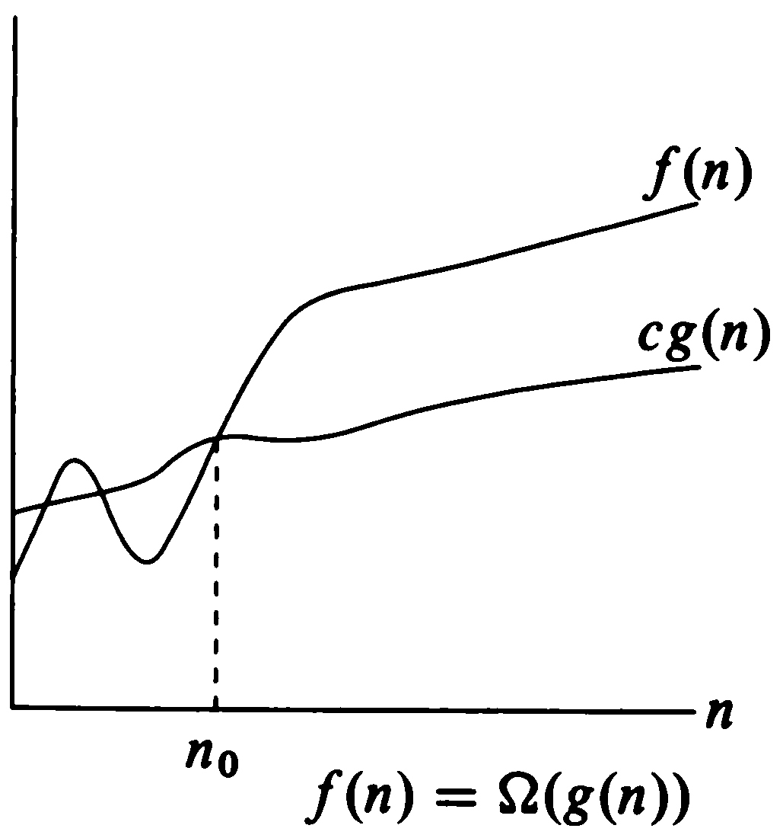
Ω-Notation (“Big-Omega”)
Asymptotic Lower Bound
Borahan Tümer
Notes:
Week #1

Slide 19
o-Notation (“Little Oh”)
Upper bound NOT Asymptotically Tight
“o” notation does not reveal whether the function f(n) is a tight asymptotic upper bound for t(n) (t(n)≤ cf(n)).
“Little Oh” or o notation provides an upper bound that strictly is NOT asymptotically tight.
Mathematically expressed;
Let f: N → R* be an arbitrary function.
o(f(n)) = {t: N → R* | (∃c ∈ R⁺)(∃n₀ ∈ N)(∀n ≥ n₀) [t(n)< cf(n)]},
  where R* is the set of nonnegative real numbers and R⁺ is the set of strictly positive real numbers (excluding 0).
Borahan Tümer

Slide 20
ω-Notation (“Little-Omega”)
Lower Bound NOT Asymptotically Tight
ω concept relates to Ω concept in analogy to the relation of “little-Oh” concept to “big-Oh” concept.
“Little Omega” or ω notation provides a lower bound that strictly is NOT asymptotically tight.
Mathematically expressed, the “Little Omega” (ω()) concept is as follows:
Let f: N → R* be an arbitrary function.
ω(f(n)) = {t: N → R* | (∃c ∈ R⁺)(∃n₀ ∈ N)(∀n ≥ n₀) [cf(n) < t(n)]},
  where R* is the set of nonnegative real numbers and R⁺ is the set of strictly positive real numbers (excluding 0).
Borahan Tümer

Slide 21
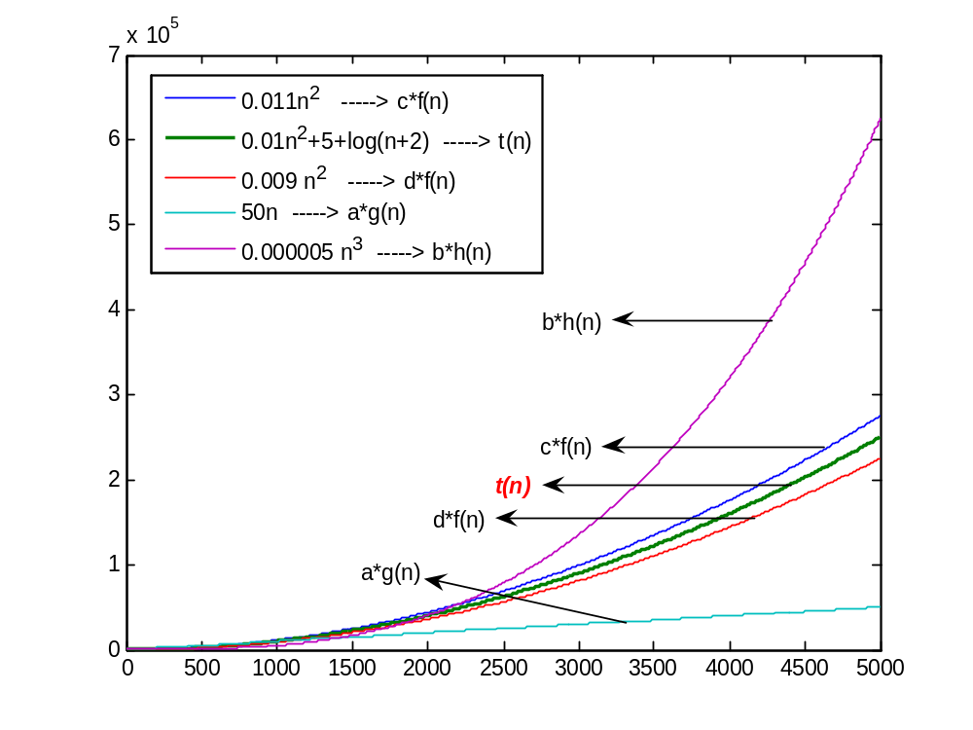
Asymptotic Notations
Examples
t(n) ∈ O(f(n))
t(n) ∈ O(h(n))
t(n) ∈ Θ(f(n))
t(n) ∉ Θ(h(n))
t(n) ∉ Θ(g(n))
t(n) ∈ Ω(f(n))
t(n) ∈ Ω(g(n))
t(n) ∈ o(h(n))
t(n) ∉ o(f(n))
t(n) ∈ ω(g(n))
t(n) ∉ ω(f(n))
Upper bound not asymptotically tight
Asymptotic upper bound
Execution time of algorithm
Asymptotic lower bound
Lower bound not asymptotically tight
Borahan Tümer

Slide 22
Execution time of various structures
Simple Statement
  O(1), executed within a constant amount of time
  irresponsive to any change in input size.
Decision (if) structure
if (condition) f(n) else g(n)
O(if structure)=max(O(f(n)),O(g(n))
Sequence of Simple Statements
O(1), since O(f₁(n)+…+f_{s}(n))=O(max(f₁(n),…,f_{s}(n)))
Borahan Tümer

Slide 23
Execution time of various structures
O(f₁(n)+…+f_{s}(n))=O(max(f₁(n),…,f_{s}(n))) ???
Proof:
t(n)∈ O(f₁(n)+…+f_{s}(n)) ⇒ t(n)≤ c[f₁(n)+…+f_{s}(n)] ≤ sc*max [f₁(n),…, f_{s}(n)],sc another constant.
⇒ t(n)∈ O(max(f₁(n),…,f_{s}(n)))
Hence, hypothesis follows.
Borahan Tümer

Slide 24
Execution Time of Loop Structures
Loop structures’ execution time depends upon whether or not their index bounds are related to the input size.
Assume n is the number of input records
for (i=0; i<=n; i++) {statement block}, O(?)
for (i=0; i<=m; i++) {statement block}, O(?)
Borahan Tümer

Slide 25
Examples
  Find the execution time t(n) in terms of n!
  for (i=0; i<=n; i++)
  for (j=0; j<=n; j++)
  statement block;
  for (i=0; i<=n; i++)
  for (j=0; j<=i; j++)
  statement block;
  for (i=0; i<=n; i++)
  for (j=1; j<=n; j*=2)
  statement block;
Borahan Tümer

Slide 26
Exercises
  Find the number of times the statement block is executed!
  for (i=0; i<=n; i++)
  for (j=1; j<=i; j*=2)
  statement block;
  for (i=1; i<=n; i*=3)
  for (j=1; j<=n; j*=2)
  statement block;
Borahan Tümer

Slide 27
Sparse Vectors and Matrices

Slide 28
Motivation
In numerous applications, we may have to process vectors/matrices which mostly contain trivial information (i.e., most of their entries are zero!). This type of vectors/matrices are defined to be sparse.
Storing sparse vectors/matrices as usual (e.g., matrices in a 2D array or a vector a regular 1D array) causes wasting memory space for storing trivial information.
Example: What is the space requirement for a matrix m_{nxn} with only non-trivial information in its diagonal if
  it is stored in a 2D array;
  in some other way? Your suggestions?
Borahan Tümer

Slide 29
Sparse Vectors and Matrices
This fact brings up the question:
May the vector/matrix be stored in MM avoiding waste of memory space?
Borahan Tümer

Slide 30
Sparse Vectors and Matrices
Assuming that the vector/matrix is static (i.e., it is not going to change throughout the execution of the program), we should study two cases:
    Non-trivial information is placed in the vector/matrix following a specific order;
    Non-trivial information is randomly placed in the vector/matrix.
Borahan Tümer

Slide 31
Case 1: Info. follows an order
Example structures:
  Triangular matrices (upper or lower triangular matrices)
  Symmetric matrices
  Band matrices
  Any other types ...?
Borahan Tümer

Slide 32
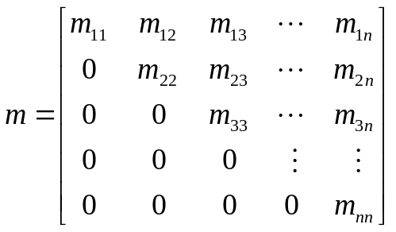
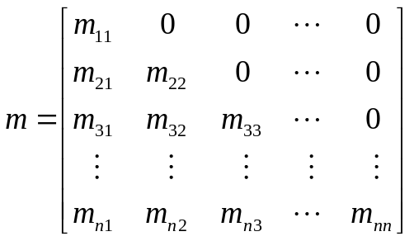
Triangular Matrices
Upper Triangular Matrix
Lower Triangular Matrix
Borahan Tümer

Slide 33
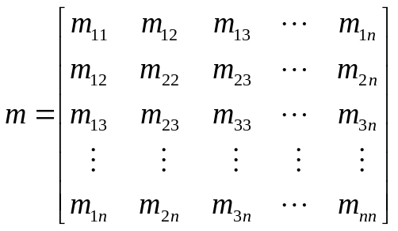
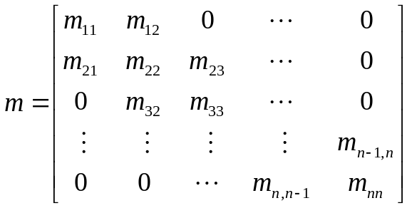
Symmetric and Band Matrices
Symmetric Matrix
Band Matrix
Borahan Tümer

Slide 34
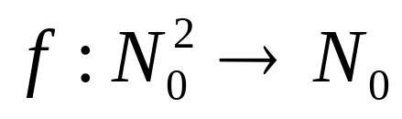
Case 1:How to Efficiently Store...
Store only the non-trivial information in a 1-dim array a;
Find a function f mapping the indices of the 2-dim matrix (i.e., i and j) to the index k of 1-dim array a, or
such that
k=f(i,j)
Borahan Tümer

Slide 35
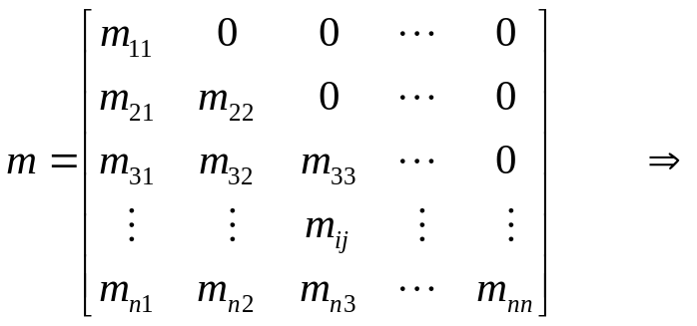
Case 1: Example for Lower Triangular Matrices
k → 0 1 2 3 4 5 .... n(n-1)/2 ....
m₁₁
m₂₁
m₂₂
m₃₁
m₃₂
m₃₃
.....
m_{n1}
m_{n2}
m_{n3}
......
m_{nn}
k=f(i,j)=i(i-1)/2+j-1
⇒
m_{ij} = a[i(i-1)/2+j-1]
Borahan Tümer

Slide 36
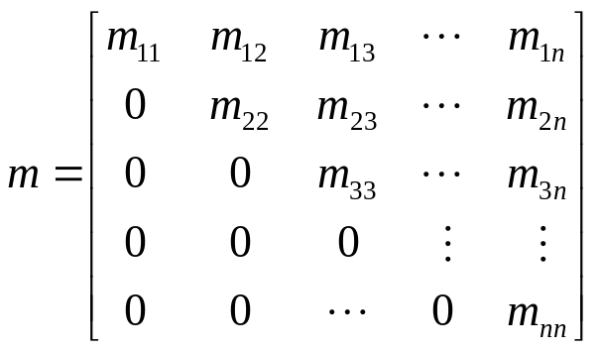
Case 1: Example for Upper Triangular Matrices
k → 0 1 2 … n-1 n .... 2n-2 2n-1…3n-4… n(n+1)/2-1
m₁₁
m₁₂
m₁₃
…
m_{1n}
m₂₂
.....
m_{2n}
m₃₃
m_{3n}
......
m_{nn}
m₁₁ at k=0 m_{1j} at k=j-1
m₂₂ at k=n m_{2j} at k=n+j-2
m₃₃ at k=2n-1 m_{3j} at k=2n-1+j-3
m₄₄ at k=3n-3 m_{4j} at k=3n-3+j-4
m₅₅ at k=4n-6 m_{5j} at k=4n-6+j-5
m₆₆ at k=5n-10 m_{5j} at k=5n-10+j-6
…
m_{ii} at k=(i-1)n-(i-2)(i-1)/2 m_{ij} at k=(i-1)n- (i-2)(i-1)/2+j-i
Borahan Tümer

Slide 37
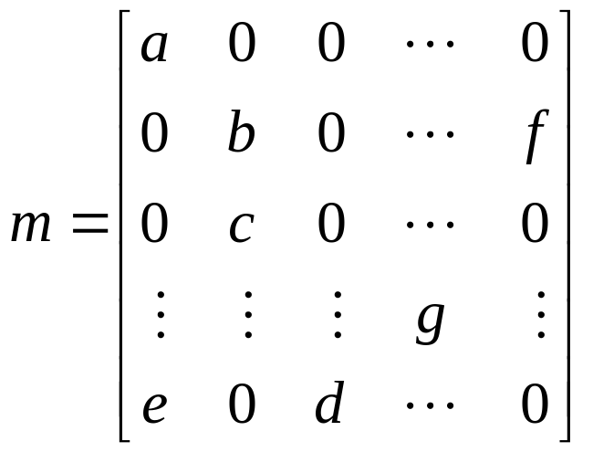
Case 2: Non-trivial Info. Randomly Located
Example:
Borahan Tümer

Slide 38
Case 2:How to Efficiently Store...
Store only the non-trivial information in a 1-dim array a along with the entry coordinates.
Example:
a
a;0,0
b;1,1
f;1,n-1
c;2,1
g;i,j
e;n-1,0
d;n-1,2
Borahan Tümer

Slide 39
Recursion

Slide 40
Recursion
Definition:
Recursion is a mathematical concept referring
to programs or functions calling or using
itself.
A recursive function is a functional piece of
code that invokes or calls itself.
Borahan Tümer

Slide 41
Recursion
Concept:
A recursive function divides the problem into two conceptual pieces:
  a piece that the function knows how to solve (base case),
  a piece that is very similar to, but a little simpler than, the original problem, hence still unknown how to solve by the function (call(s) of the function to itself).
Borahan Tümer

Slide 42
Recursion… cont’d
Base case: the simplest version of the problem that is not further reducible. The function actually knows how to solve this version of the problem.
To make the recursion feasible, the latter piece must be slightly simpler.
Borahan Tümer

Slide 43
Recursion Examples
Towers of Hanoi
Story: According to the legend, the life on the world will end when Buddhist monks in a Far-Eastern temple move 64 disks stacked on a peg in a decreasing order in size to another peg. They are allowed to move one disk at a time and a larger disk can never be placed over a smaller one.
Borahan Tümer

Slide 44
Towers of Hanoi… cont’d
Algorithm:
Hanoi(n,i,j)
// moves n smallest rings from rod i to rod j
F0A0 if (n > 0) {
//moves top n-1 rings to intermediary rod (6-i-j)
F0A2 Hanoi(n-1,i,6-i-j);
//moves the bottom (n^{th} largest) ring to rod j
F0A5 move i to j
// moves n-1 rings at rod 6-i-j to destination rod j
F0A8 Hanoi(n-1,6-i-j,j);
F0AB }
Borahan Tümer

Slide 45
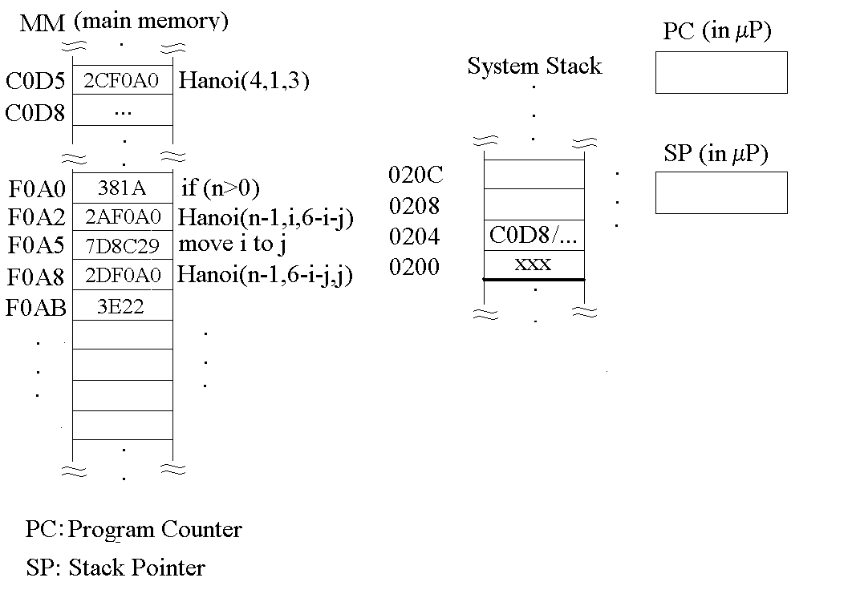
Function Invocation in MM
Borahan Tümer

Slide 46
Function Invocation (Call) in MM
Code and data are both in MM.
Hanoi function is called by the instruction at MM cell C0D5 with arguments (4,1,3).
Program counter is a register in μP that holds MM address of next instruction to execute.
If current instruction is a function call, the serial flow of execution is interrupted.
Borahan Tümer

Slide 47
Function Call in MM… cont’d
Following problems arise:
  how to keep the return address from the function called (Hanoi) back to the caller function (C0D8 at main and both F0A5 and F0AB at Hanoi);
  how to store the values of variables local to caller function.
Both problems are solved by keeping the return address and local variables’ values in a portion of the main memory called system stack.
Another register called Stack Pointer points to the address pushed most recently to system stack. Return addresses are retrieved from system stack in a last-in-first-out (LIFO) fashion. We will see stacks later.
Borahan Tümer

Slide 48
Towers of Hanoi… cont’d
Example: Hanoi(4,i,j)
4 1 3
3 1 2
2 1 3
1 1 2
0 1 3
1→2
0 3 2
1→3
1 2 3
0 2 1
2→3
0 1 3
1→2
2 3 2
1 3 1
0 3 2
3→1
0 2 1
3→2
1 1 2
0 1 3
1→2
0 3 2
1→3
3 2 3
2 2 1
1 2 3
0 2 1
2→3
0 1 3
2→1
1 3 1
0 3 2
3→1
0 2 1
2→3
2 1 3
1 1 2
0 1 3
1→2
0 3 2
1→3
1 2 3
0 2 1
2→3
0 1 3
Borahan Tümer

Slide 49
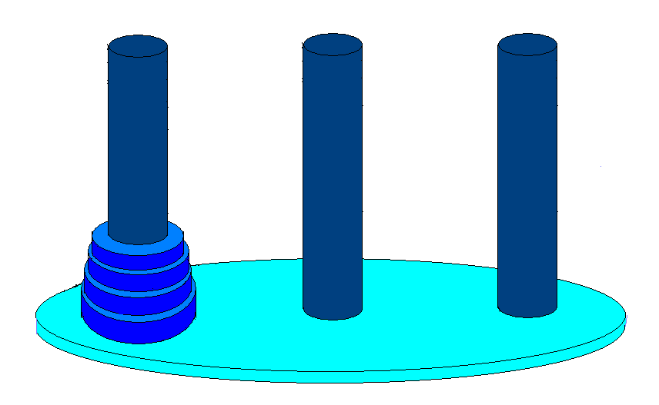
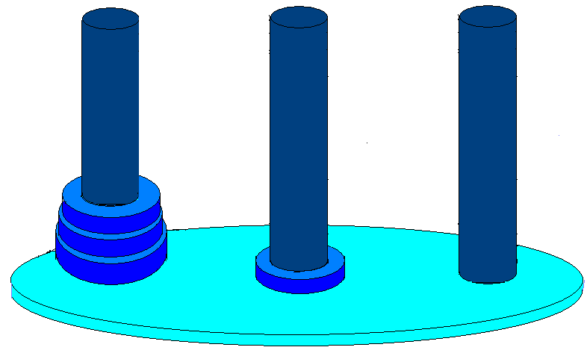
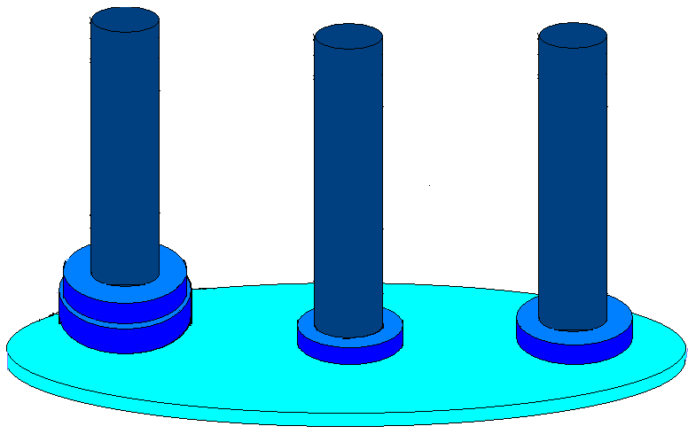
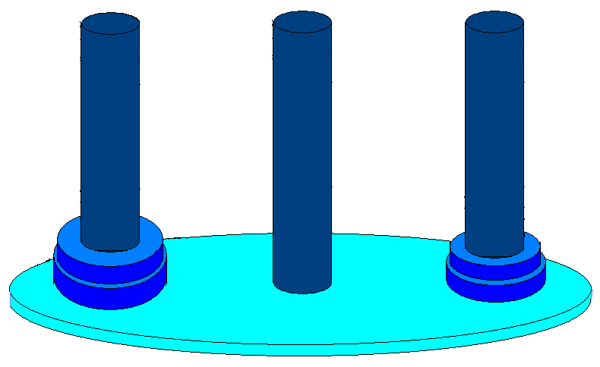
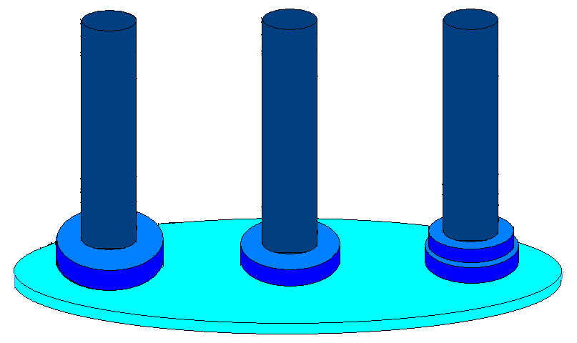
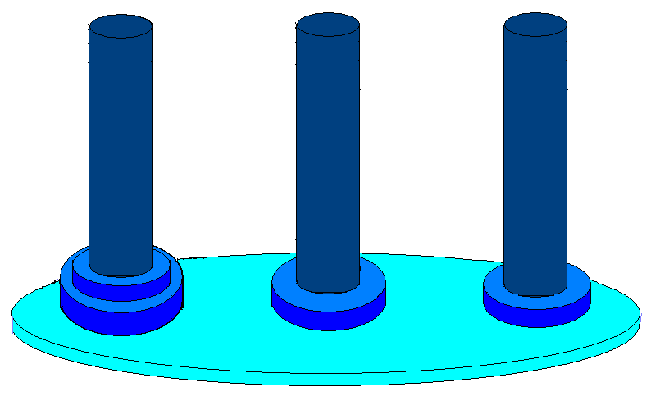
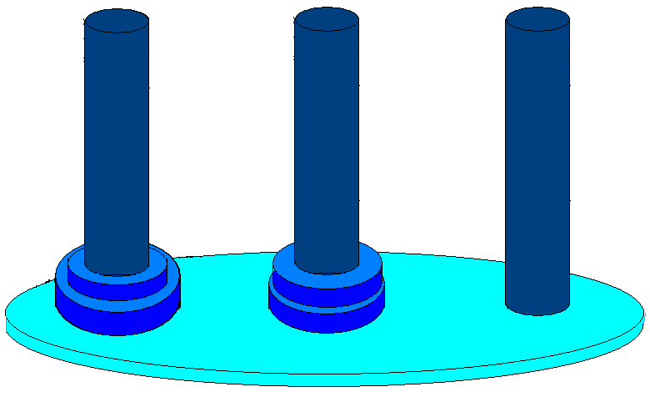
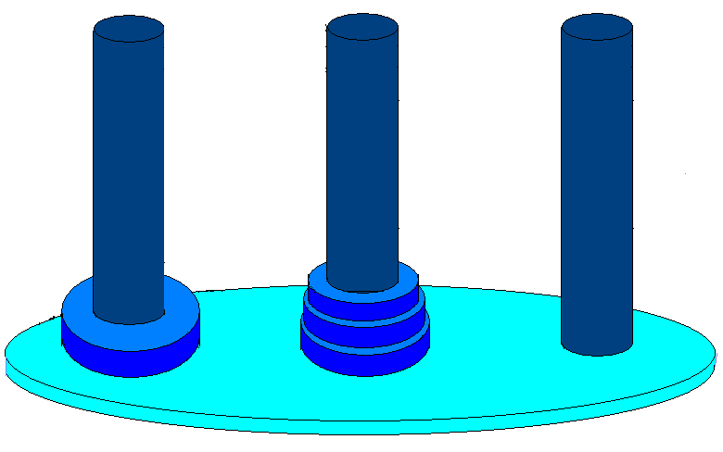
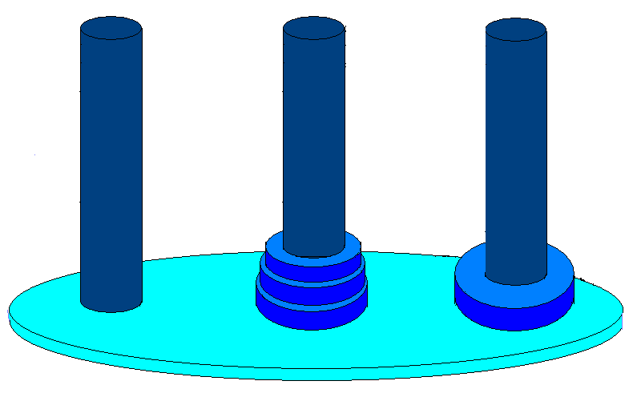
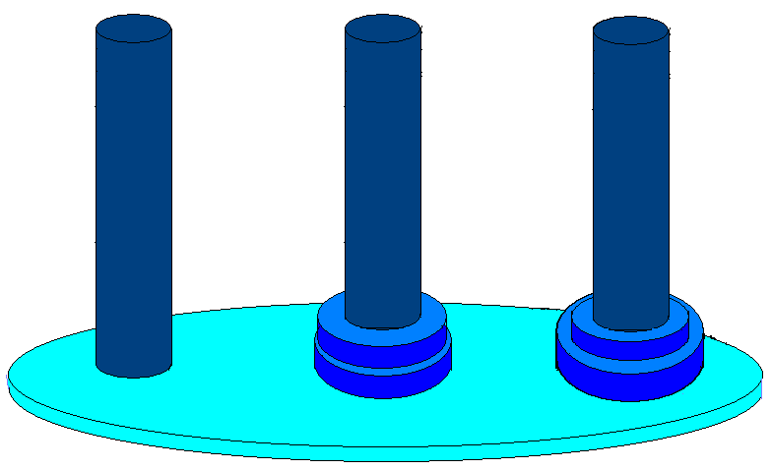
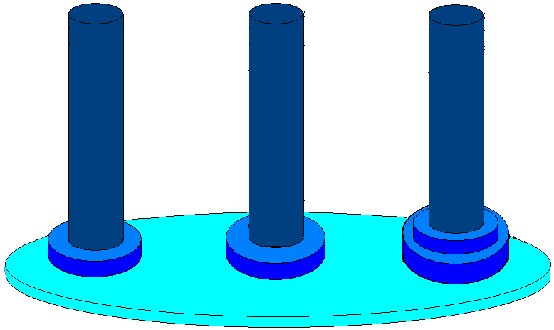
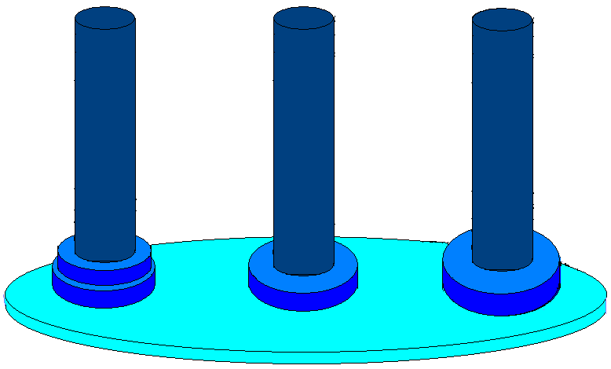
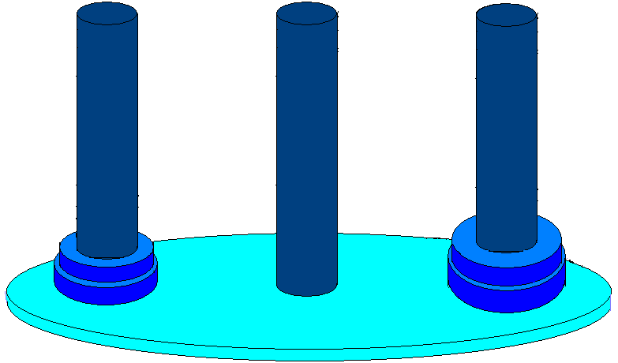
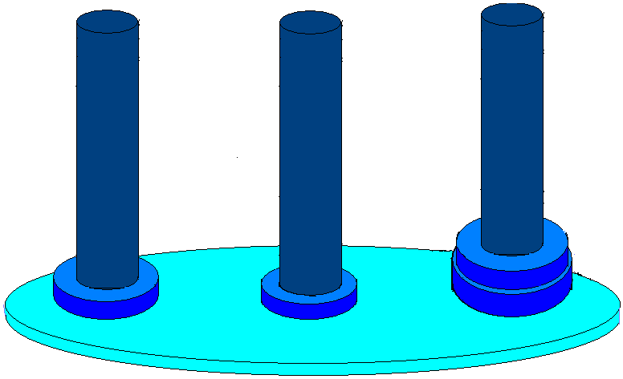
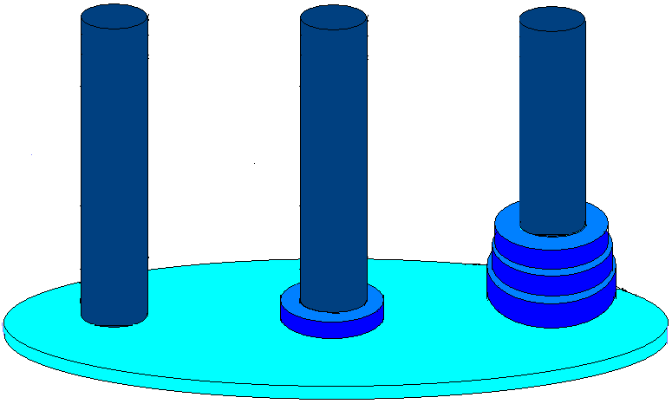
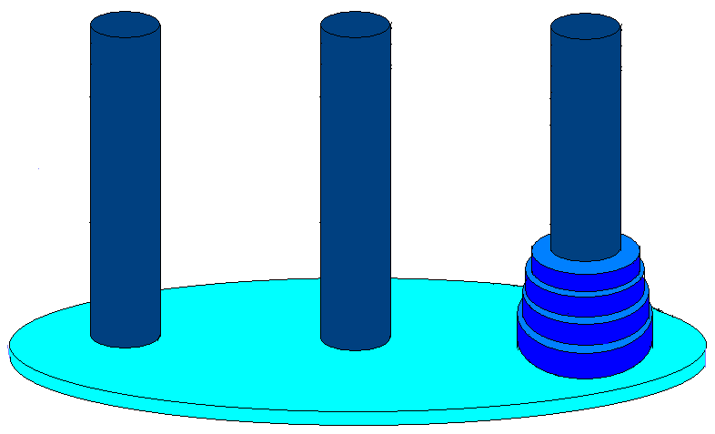
Towers of Hanoi… cont’d
4 1 3 start
3 1 2 start
2 1 3 start
1 1 2 start
1 2 3 end
2 1 3 end
2 3 2 start
1 3 1 start
1 1 2 end
1 2 3 start
1→2
1→3
2→3
1→2
3 1 2 end
2 3 2 end
1 1 2 end
3 2 3 start
2 2 1 start
1 2 3 start
1 3 1 end
1 1 2 start
1 2 3 end
3→1
3→2
1→2
1→3
2→3
1 3 1 start
2 2 1 end 1 3 1 end
2 1 3 start
1 1 2 start
1 1 2 end
1 2 3 start
2→1
3→1
2→3
1→2
1→3
2→3
4 1 3 end
3 2 3 end
2 1 3 end
1 2 3 end
Borahan Tümer

Slide 50
Recursion Examples
Fibonacci Series
  t_{n}= t_{n-1} + t_{n-2}; t₀=0; t₁=1
Algorithm
long int fib(n)
{
if (n==0 || n==1)
return n;
else
return fib(n-1)+fib(n-2);
}
Borahan Tümer

Slide 51
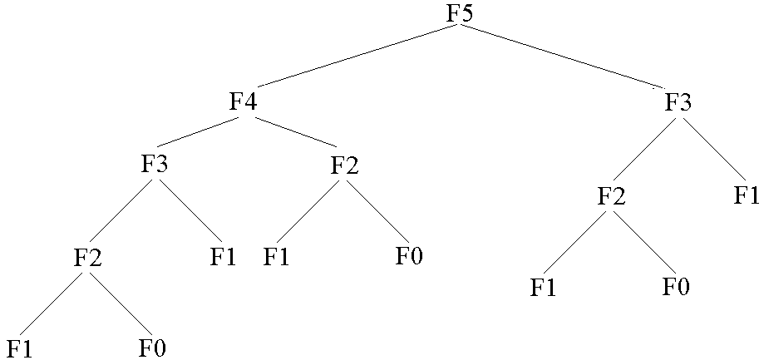
Fibonacci Series… cont’d
Tree of recursive function calls for fib(5)
Any problems???
Borahan Tümer

Slide 52
Fibonacci Series… cont’d
Redundant function calls slow the execution down.
A lookup table used to store the Fibonacci values already computed saves redundant function executions and speeds up the process.
Homework: Write fib(n) with a lookup table!
Borahan Tümer

Slide 53
Recurrences

Slide 54
Recurrences or Difference Equations
Homogeneous Recurrences
Consider a₀ t_{n} + a₁t_{n-1} + … + a_{k} t_{n-k} = 0.
The recurrence
  contains t_{i} values which we are looking for.
  is a linear recurrence (i.e., t_{i} values appear alone, no powered values, divisions or products)
  contains constant coefficients (i.e., a_{i}).
  is homogeneous (i.e., RHS of equation is 0).
Borahan Tümer

Slide 55
Homogeneous Recurrences
We are looking for solutions of the form:
t_{n} = x^{n}
Then, we can write the recurrence as
a₀ x^{n} + a₁x^{n-1}+ … + a_{k} x^{n-k} = 0
This k^{th} degree equation is the characteristic equation (CE) of the recurrence.
Borahan Tümer

Slide 56
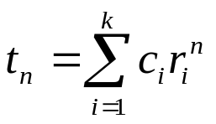
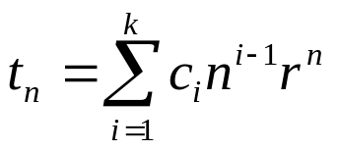
Homogeneous Recurrences
If r_{i}, i=1,…, k, are k distinct roots of a₀ x^{k} + a₁ x^{k-1}+ … + a_{k} = 0, then
If r_{i}, i=1,…, k, is a single root of multiplicity k, then
Borahan Tümer

Slide 57
Inhomogeneous Recurrences
Consider
a₀ t_{n} + a₁t_{n-1} + … + a_{k} t_{n-k} = b^{n} p(n)
where b is a constant; and p(n) is a polynomial in n of degree d.
Borahan Tümer

Slide 58
Inhomogeneous Recurrences
Generalized Solution for Recurrences
Consider a general equation of the form
(a₀ t_{n} + a₁t_{n-1} + … + a_{k} t_{n-k} ) = b₁^{n} p₁(n) + b₂^{n} p₂(n) + …
We are looking for solutions of the form:
t_{n} = x^{n}
Then, we can write the recurrence as
where d_{i} is the polynomial degree of polynomial p_{i}(n).
This is the characteristic equation (CE) of the recurrence.
Borahan Tümer

Slide 59
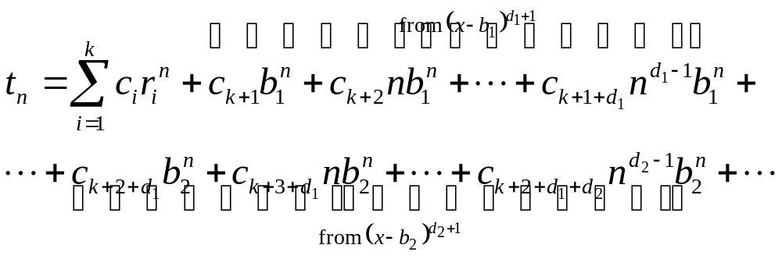
Generalized Solution for Recurrences
If r_{i}, i=1,…, k, are k distinct roots of
(a₀ x^{k} + a₁ x^{k-1}+ … + a_{k})=0
Borahan Tümer

Slide 60
Examples
Homogeneous Recurrences
Example 1.
t_{n} + 5t_{n-1} + 4 t_{n-2} = 0; sol’ns of the form t_{n} = x^{n}
x^{n} + 5x^{n-1}+ 4x^{n-2} = 0; (CE) n-2 trivial sol’ns (i.e., x_{1,...,n-2}=0)
(x²+5x+4) = 0; characteristic equation (simplified CE)
x₁=-1; x₂=-4; nontrivial sol’ns
t_{n} = c₁(-1)^{n}+ c₂(-4)^{n} ; general sol’n
Borahan Tümer

Slide 61
Examples
Homogeneous Recurrence
Example 2.
t_{n}-6 t_{n-1}+12t_{n-2}-8t_{n-3}=0; t_{n} = x^{n}
x^{n}-6x^{n-1}+12x^{n-2}-8x^{n-3}= 0; n-3 trivial sol’ns
CE: (x³-6x²+12x-8) = (x-2)³= 0; by polynomial division
x₁= x₂= x₃ = 2; roots not distinct!!!
t_{n} = c₁2^{n}+ c₂n2^{n} + c₃n²2^{n}; general sol’n
Borahan Tümer

Slide 62
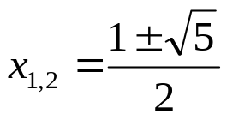
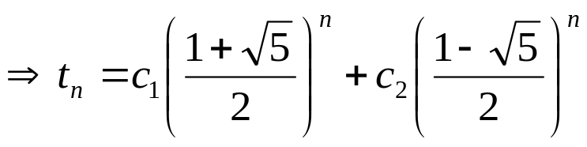
Examples
Homogeneous Recurrence
Example 3.
t_{n} = t_{n-1}+ t_{n-2}; Fibonacci Series
x^{n}-x^{n-1}-x^{n-2} = 0; ⇒ CE: x²-x-1 = 0;
; distinct roots!!!
; general sol’n!!
We find coefficients c_{i} using initial values t₀ and t₁ of
Fibonacci series on the next slide!!!
Borahan Tümer

Slide 63
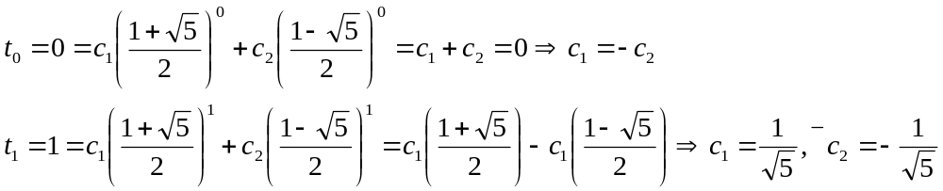
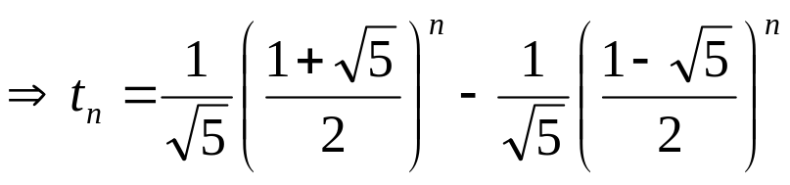
Examples
Example 3… cont’d
We use as many t_{i} values
as c_{i}
Check it out using t₂!!!
Borahan Tümer

Slide 64
Examples
Example 3… cont’d
What do n and t_{n} represent?
n is the location and t_{n} the value of any Fibonacci number in the series.
Borahan Tümer

Slide 65
Examples
Example 4.
t_{n} = 2t_{n-1} - 2t_{n-2}; n ≥ 2; t₀ = 0; t₁ = 1;
CE: x²-2x+2 = 0;
Complex roots: x_{1,2}=1±i
As in differential equations, we represent the complex roots as a
vector in polar coordinates by a combination of a real radius r
and a complex argument θ:
z=r*e^{θ i};
Here,
1+i=√2 * e^{(π/4)i}
1-i=√2 * e^{(-π/4)i}
Borahan Tümer

Slide 66
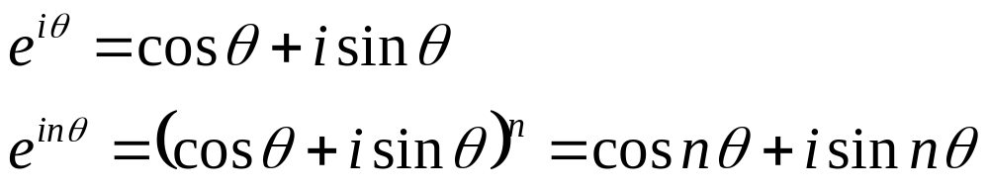
Examples
Example 4… cont’d
Solution:
t_{n} = c₁ (2)^{n/2} e^{(nπ/4)i} + c₂ (2)^{n/2} e^{(-nπ/4)i};
From initial values t₀ = 0, t₁ = 1,
t_{n} = 2^{n/2} sin(nπ/4); (prove that!!!)
Hint:
Borahan Tümer

Slide 67
Examples
Inhomogeneous Recurrences
Example 1. (From Example 3)
We would like to know how many times fib(n)
on page 22 is executed in terms of n. To find out:
choose a barometer in fib(n);
devise a formula to count up the number of times the barometer is executed.
Borahan Tümer

Slide 68
Examples
Example 1… cont’d
In fib(n), the only statement is the if statement.
Hence, if condition is chosen as the barometer.
Suppose fib(n) takes t_{n} time units to execute,
where the barometer takes one time unit and the
function calls fib(n-1) and fib(n-2), t_{n-1} and t_{n-2},
respectively. Hence, the recurrence to solve is
t_{n} = t_{n-1} + t_{n-2} + 1
Borahan Tümer

Slide 69
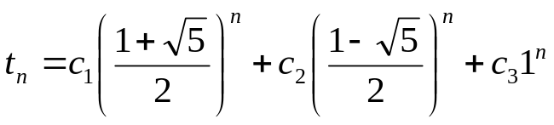
Examples
Example 1… cont’d
t_{n} - t_{n-1} - t_{n-2} = 1; inhomogeneous recurrence
The homogeneous part comes directly from
Fibonacci Series example on page 52.
RHS of recurrence is 1 which can be expressed
as 1^{n}x⁰. Then, from the equation on page 48,
CE: (x²-x-1)(x-1) = 0; from page 49,
Borahan Tümer

Slide 70
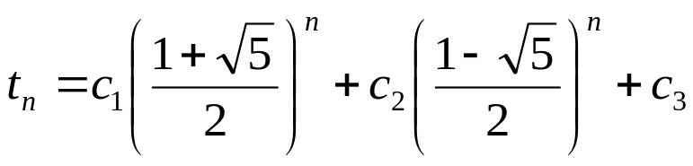
Examples
Example 1… cont’d
Now, we have to find c₁,…,c₃.
Initial values: for both n=0 and n=1, if condition is
checked once and no recursive calls are done.
For n=2, if condition is checked once and recursive
calls fib(1) and fib(0) are done.
⇒ t₀ = t₁ = 1 and t₂ = t₀ + t₁ + 1 = 3.
Borahan Tümer

Slide 71
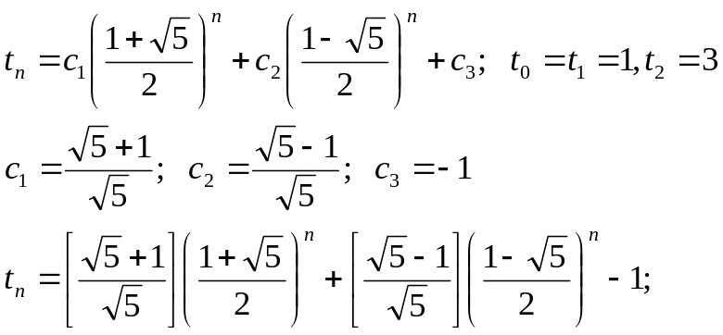
Examples
Example 1… cont’d
Here, t_{n} provides the number of times the
barometer is executed in terms of n. Practically,
this number also gives the number of times fib(n) is
called.
Borahan Tümer

